Slide 1
Intellectual and/or Developmental Disabilities (IDD):
The importance of understanding differences and neurodiversity

Slide 2
What is a disability? What is intellectual and/or developmental disability?

Slide 3
Neurodiversity falls under the IDD umbrella!

Slide 4
What are some examples of IDD?
Autism Spectrum Disorder
ADHD
Learning disabilities: Dyslexia, auditory dyslexia, dyscalculia
Tourette Syndrome
Cerebral Palsy
Down Syndrome
Fragile X Syndrome

Slide 6
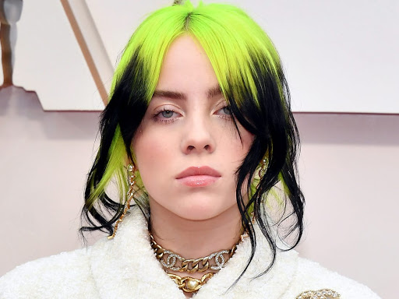
Do we know people with IDD?
This Photo by Unknown Author is licensed under CC BY-SA-NC

Slide 7
What can YOU do?

