Slide 1
Bob Napolilli, Kelsey Edwards, and Randall Cole
2214 Dundee Road, Suite A
Louisville, KY, 40205
www.councilondd.org
502-584-1239

Slide 2
Who We Are!
We are a small nonprofit with a great big vision: a society that includes, values and empowers children, youth and adults with IDD. Our mission is to initiate positive change on behalf of our constituents. The Council is a Louisville-based nonprofit rooted in advocacy of fully inclusive lives for individuals of all ages who have developmental and/or intellectual disabilities.
The Council helps individuals, families and caregivers by providing one-on-one guidance, training events and social events to navigate essential community resources to help individuals live their best lives. We are here to serve your family for a lifetime, offering training and empowerment through all the stages of your journey.

Slide 3
What We Do
A resource hub
Holistic, person-centered approach to serve our communities
Trauma-Informed organization
The Council services its constituents using three pillars of services:
Education
Advocacy
Support

Slide 4
Education
The Council offers different trainings to help educate the IDD and their caregivers, these include:
Financial-empowerment
Health and wellness
Transitions
Support Decision-Making
Guardianship and Conservatorship
Disability Rights and Benefits

Slide 5
Advocacy
Equity program-incarceration, school-to-prison pipeline
Adult changing tables
Developing relationships with the school district to provide resources to children with IDD
Funding for waiver services
Transportation
Person-centered planning
Self-agency

Slide 6
Support
The Council Closet
Support groups
Coffee with The Council
Peer Social Group
Finding the correct resources for a family in need
Melissa Barthle Memorial Fund for Direct Support Professionals
Providing hands-on experience to gradate level students in the Kent School of Social Work

Slide 7
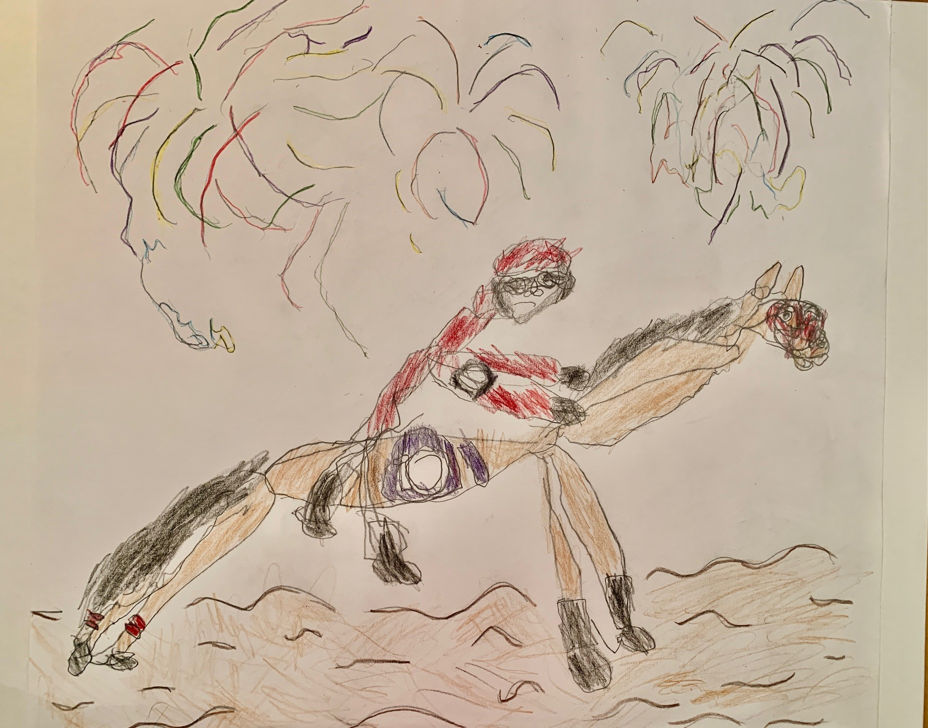
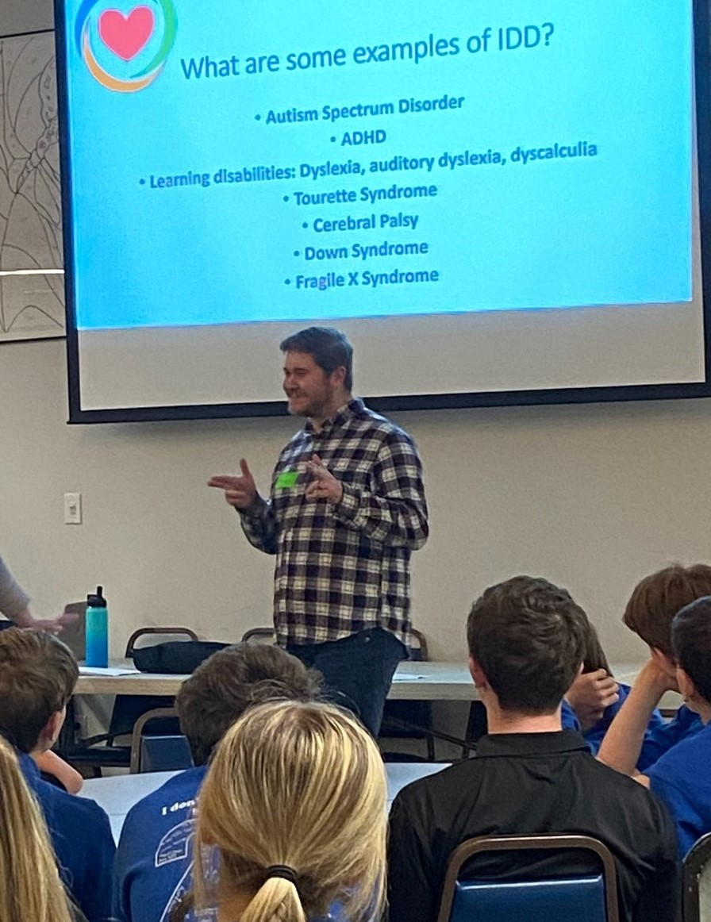
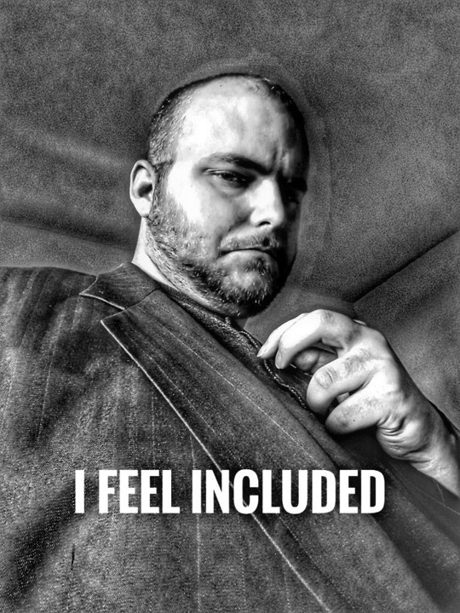
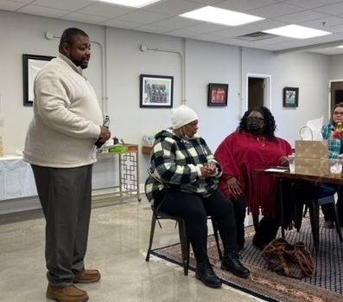
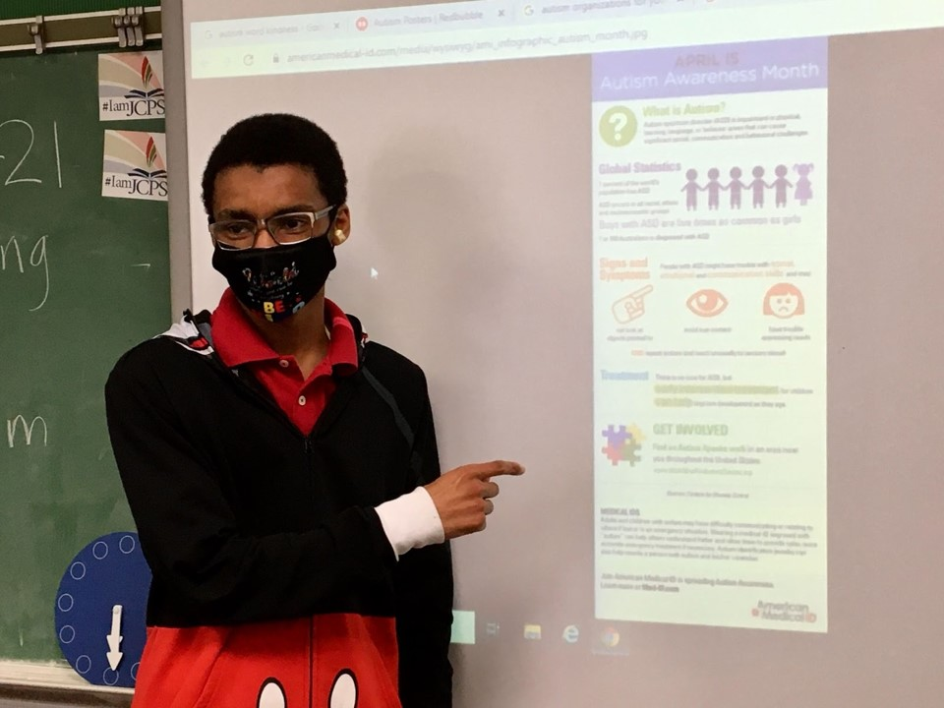
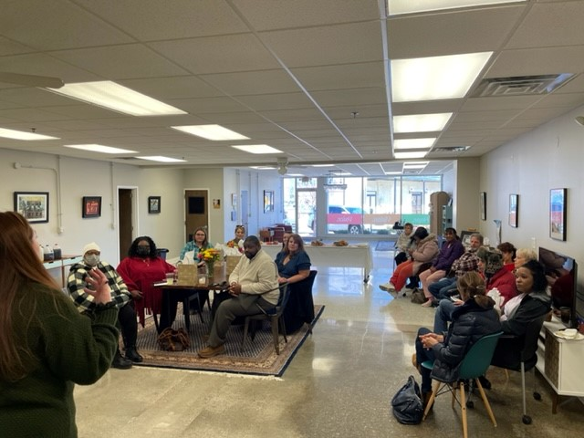
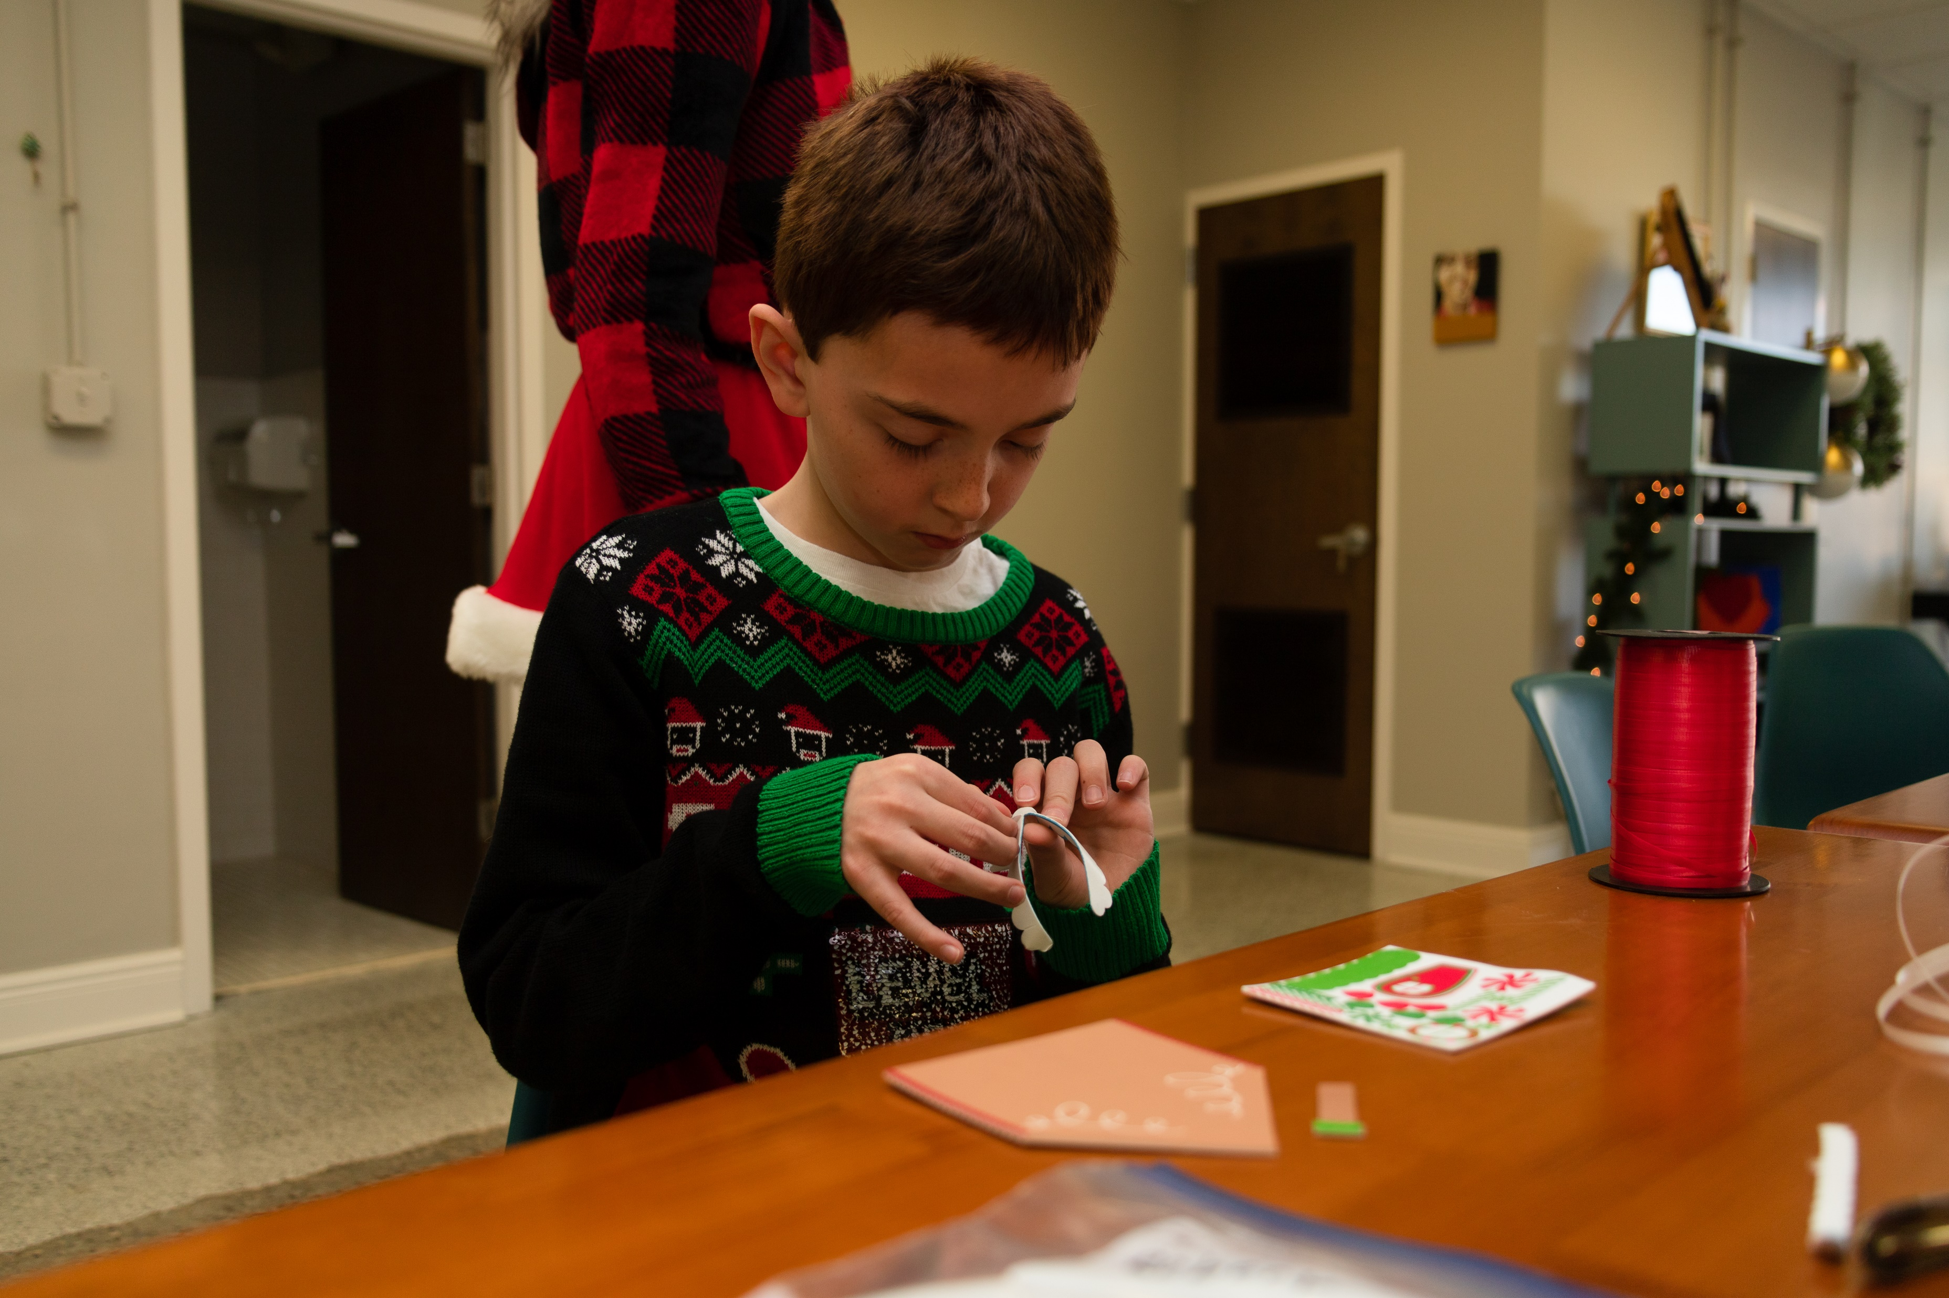
Community Outreach and Engagement

Slide 8
What’s Next?
Short-term: case management
Community center
Health & Wellness program expansion
Self-advocacy seminars
Acceptance, not tolerance

