Slide 1
Advocating with the Legislature
CCDD | CCDD.KY.GOV

Slide 2
Advocacy is...
standing up for what is important to you.
using your words or actions to help change things
You can advocate...
for yourself or for a group.
by yourself or with a group.
WHAT IS ADVOCACY?

Slide 3
IT STARTS WITH YOU
To be a good advocate...
You must know your goals, your passions, your strengths and
weakness, and your partners

Slide 4
GROUP ADVOCACY
Things to do in a group...
Go to rallies or demonstrations
Attend committee meetings
Have workshops where people can learn about issues.
Talk with officials

Slide 5
THINGS TO DO ON YOUR OWN
Get to know your legislators
Write letters or emails to them
Meet with them
Google them
Follow and bills that are important to you
Pay attention to committees that are important to you
Kentucky’s Legislative Research Commission
Leave a Message for your State Legislator:
1-800-372-7181
Call your State Legislator's Office
502-564-8100

Slide 6
Public policy is...
a set of laws decided by government leaders:
like Cabinet Officials, Representatives, and the Governor
In public policy, you can advocate for...
bills
regulations
executive orders

Slide 7
Bills

Slide 8
Executive Orders

Slide 9
STATE RESPRESENTATIVES
You need to know your Senator and your Representative
https://apps.legislature.ky.gov/findyourlegislator/findyourlegislator.html
You also need to know the leaders and the Committee Chairs

Slide 13
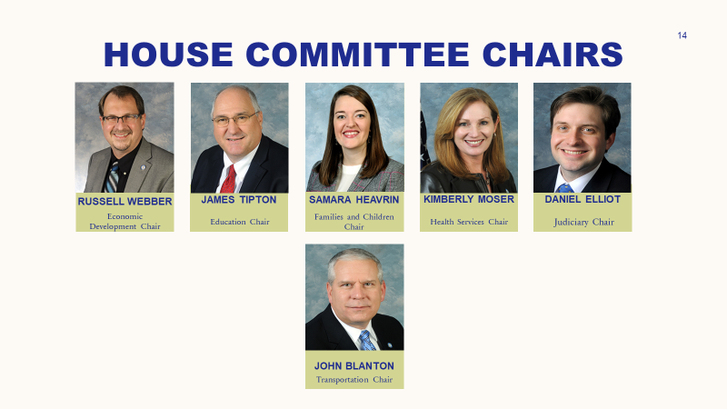

Slide 14
KENTUCKY SENATORS
Name: Senator Mitch McConnell
Phone: (859) 224-8286
Address: 771 Corporate Drive, Ste 108, Lexington, KY 40503
Name: Senator Rand Paul
Phone: 270-782-8303
Address: 1029 State Street, Bowling Green, KY 42101

Slide 15
2023 HOUSE OF REPRESENTATIVES
District 1 James Comer (202) 225-3115
District 2 Brett Guthrie (202) 225-3501
District 3 Morgan McGarvey (202) 225-5401
District 4 Thomas Massie (202) 225-3465
District 5 Harold Rogers (202) 225-4601
District 6 Andy Barr (202) 225-4706

Slide 16
You want your elected officials to know who you are! Remember, they work for you.
They are not scary, they are just people
Be PERSISTENT!! There's always someone more annoying that you
You don't need to be from their district
Try and find these answers:
Do they have a bio you can read?
Do you have anything in common?
What major issues do they focus on?
Have they written any bills?
What committees do they serve on?
GET TO KNOW YOUR LAWMAKERS

Slide 17
ELEVATOR SPEECH
What Is an Elevator Speech?
An elevator speech is a short speech that you have memorized in case you get a moment with a legislator, like riding the elevator with them.
Begin by saying...
Your first and last name
Where you live
One more important fact about you
Next, bring up the policy issue you are advocating for.
Talk about how the issue affects you or the people around you. Tell them WHY you and others need the policy you support.

Slide 18
MEETING IN PERSON
A face to face meeting with your lawmakers is powerful.
You are a valuable source of information for your leaders.
Schedule the meeting
Call your legislator’s office and ask to make an appointment
Provide your name, address, phone number, and what you want to talk about
Be polite and say thank you
Before the meeting
Email the person you talked to and confirm the time and place
Prepare some talking points about your issue and how it affects you
Practice what you are going to say

Slide 19
MEETING TIPS
Be on time
Be calm, you got this!
Be polite
Dress nicely
Address them as "Senator" or "Representative"
Thank them for their time
If you do not know the answer to a question, take notes and tell them you will follow up
Remember to be brief: You have only 15-30 minutes
Send a thank you letter or card
Follow up often to make sure they remember you

Slide 20
FACE-TO-FACE MEETING TIPS
Introduce yourself
Thank them for the chance to talk
Tell them your name
Tell them you are their constituent
Tell them where you live

Slide 21
FACE-TO-FACE MEETING TIPS
Share Your Issue
Tell them what you want to talk about:
Give Examples:
Medicaid
Housing
Transportation
Employment

Slide 22
FACE-TO-FACE MEETING TIPS
Tell Them Why It Matters
Describe how the issue impacts you or people you care for.
For example: "Affordable housing allows me and my friends to live in the community like everyone else."

Slide 23
FACE-TO-FACE MEETING TIPS
Say what you want and say thank you
Tell what you would like them to do.
For example: "I ask that you increase housing options for people with disabilities."

Slide 24
FACE-TO-FACE MEETING TIPS
Follow Up With a Note
Thank them again for their time.
Offer to help them if they need it.
Connect with them on social media if you can

Slide 25
YOUR BEST FRIEND - THE LRC
The Legislative Research Commission website has...
https://legislature.ky.gov/pages/index.aspx
Lawmaker's Information
Bill tracking
Committee Schedule
All Calendars
Guides to understanding everything
LRC's Main Phone Line and to Call your Legislator's Office
502-564-8100
Leave a Message for your State Legislator:
1-800-372-7181

Slide 26
SELF-ADVOCACY:
KNOW YOURSELF
KNOW WHAT YOU NEED AND WANT
KNOW HOW TO GET IT
This project was supported, in part by grant number 2101KYSCDD-01 from the U.S. Administration for Community Living, Department of Health and Human Services, Washington, D.C. 20201. Grantees undertaking projects with government sponsorship are encouraged to express freely their findings and conclusions. Points of view or opinions do not, therefore, necessarily represent official ACL policy.

